Slide 1

Project Alpha: A Deep Dive into AI-Powered Development
A Proof of Concept to Master the Use of Coding Agents
Developed from scratch by Coding Agent Jules

Slide 2

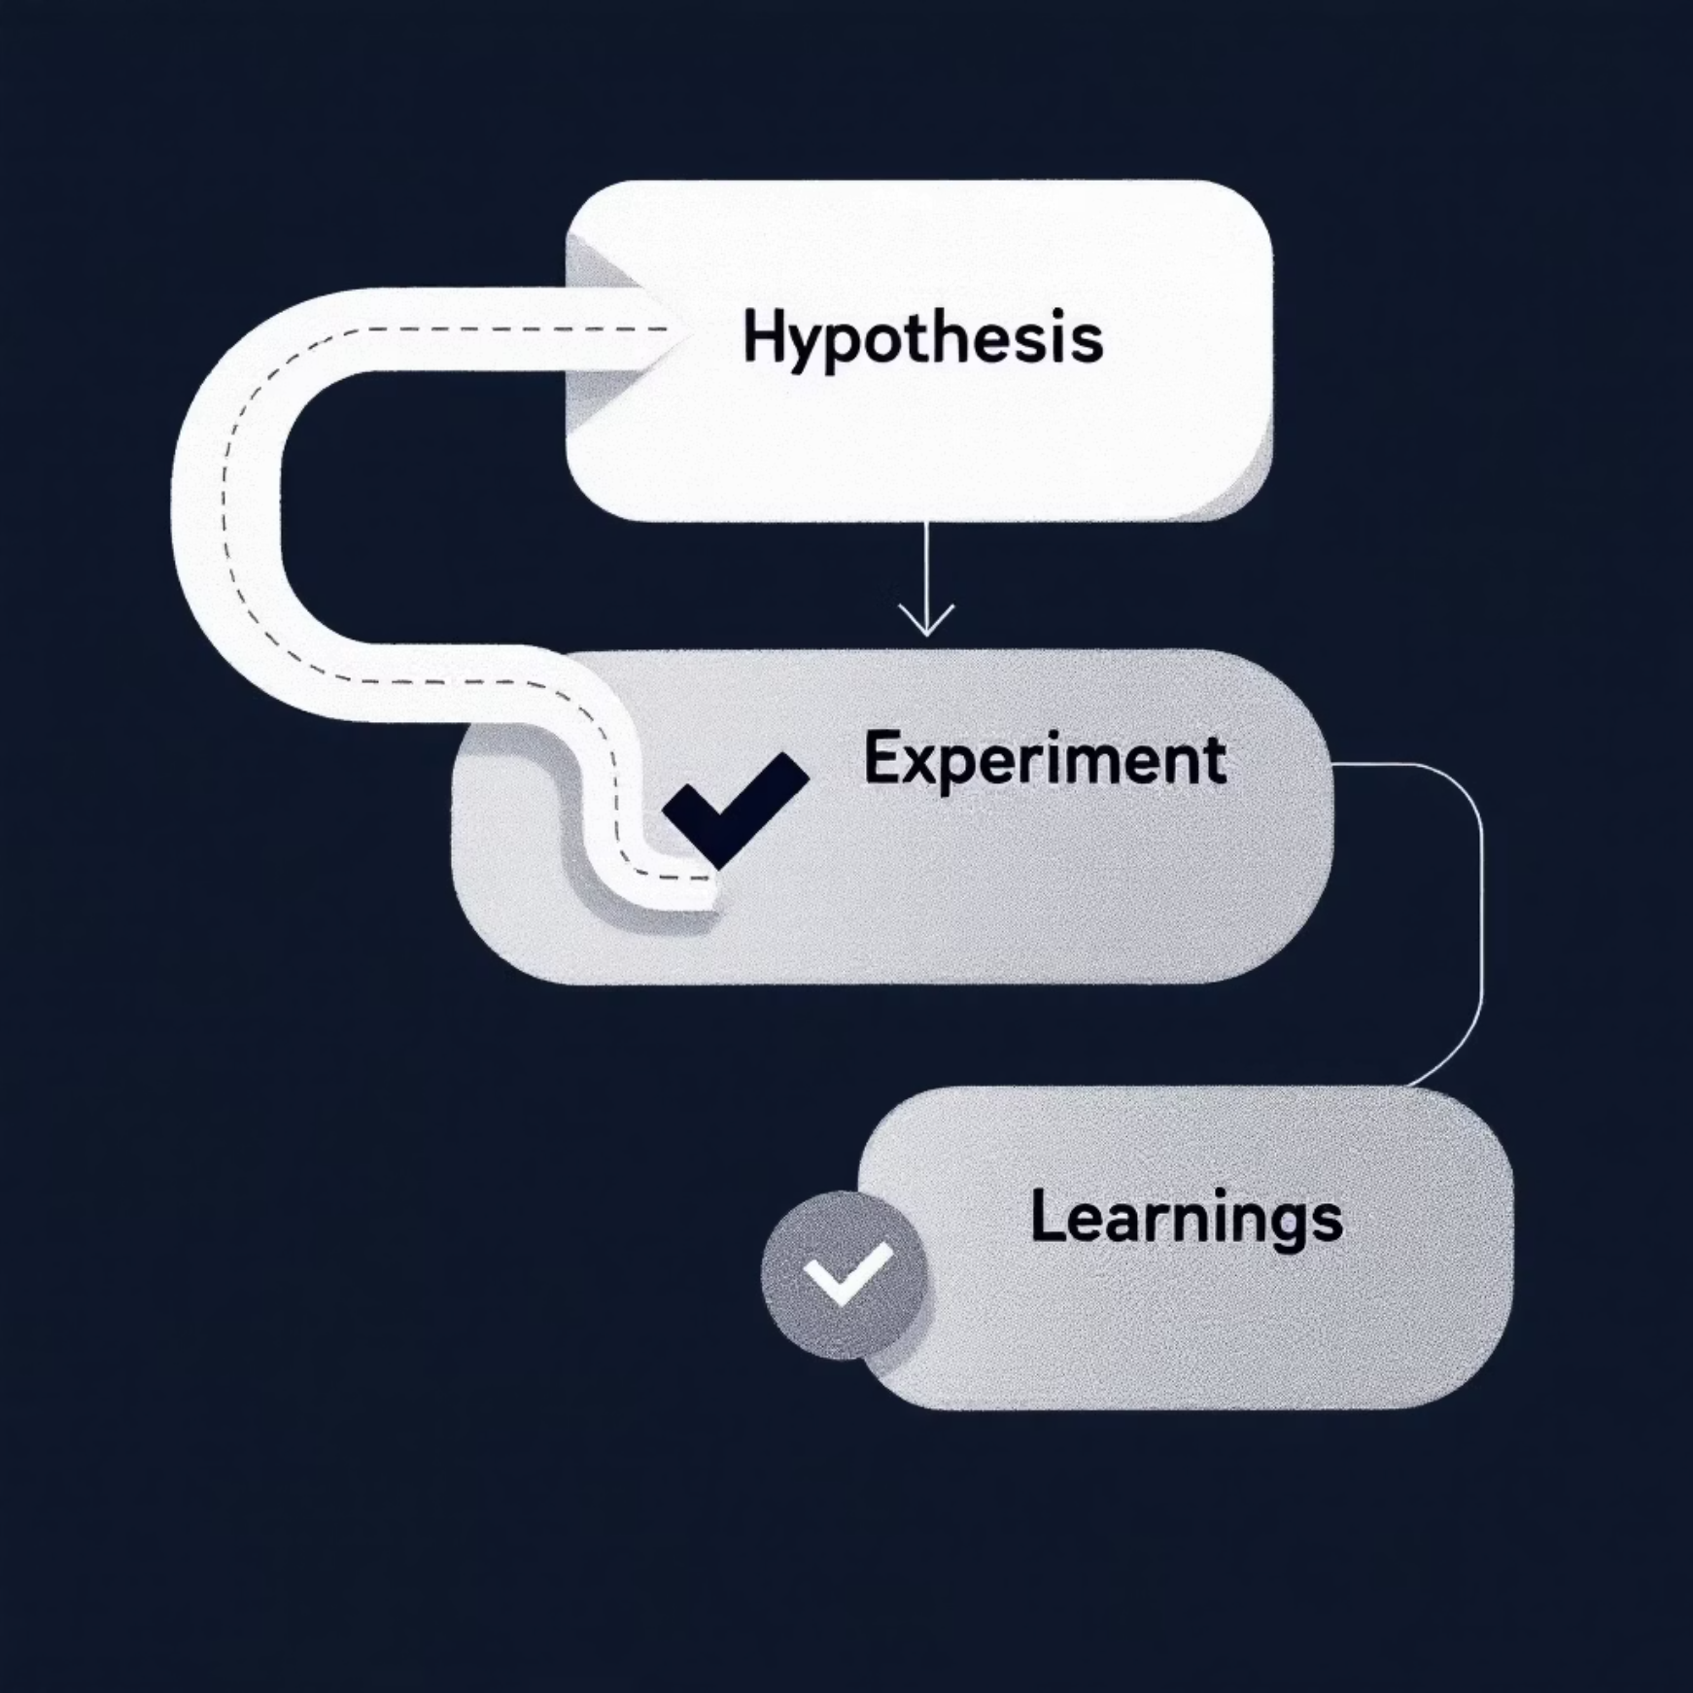
Beyond Automation: Our AI Proof of Concept
The AI Agent (Jules)
Project Alpha's Real Mission
We used a Coding Agent, "Jules," to simulate a full-stack, greenfield development project. The goal was to understand its capabilities, limitations, and how to best collaborate with AI.
This was not about replacing a manual workflow. It was a strategic Proof of Concept (POC) to meticulously document the challenges and best practices of using an AI agent to build a complex application from a cold start.

Slide 3





The Trade Processing Platform: An Architectural Overview
Inbound Kafka
Validation & Enrichment
Consumes inbound trade messages.
Validates key attributes and enriches data with fund details.
Database
Outbound Kafka
Stores data in a database for persistence.
Pushes enriched trades to an outbound topic.
Error Handling
In case of an error, logs exceptions.

Slide 4



From Code to Production: The Hard-Won Lessons
The "Brittle Foundation"
The "Overconfident Agent"
The "Missing Piece"
The agent struggled with core setup tasks like H2 to MySQL migration, often failing with persistent runtime errors due to driver scope, dialect, and startup order issues.
At times, unit-tested code would not run end-to-end. The agent also bypassed failing tests when explicitly instructed, highlighting the need for a human-led quality assurance role.
The agent sometimes provided incomplete fixes for security headers or framework configurations, requiring multiple rounds of refined, low-level feedback to resolve.

Slide 5

A Developer's Playbook for AI Collaboration
1
2
3
Start with a Detailed Blueprint
Enforce the "Clean Run" Rule
Provide Targeted, Low-Level Feedback
Clearly define architecture, dependencies, and security constraints upfront.
Do not accept code until it can be built and run in a standard environment.
Instead of "fix the bug," specify the file and method: "The isDuplicate method in DatabaseStorageService.java is incorrect."
4
5
Think Beyond the Code
The Human-AI Partnership
Use the agent for boilerplate code, tests, and documentation, freeing up developers for high-value architectural work.
The developer's role shifts to that of a strategic partner, architect, and final quality gate.

Slide 6

A Glimpse into the Future of Engineering
Key Insight: Project Alpha was a success because it provided invaluable lessons on a new development paradigm.
Future Vision: AI agents can rapidly build and accelerate development on complex applications. By applying these best practices, we can harness this power to significantly reduce development time and costs on future projects, while maintaining the highest standards of quality and resilience.

Slide 7

Technical Challenges: The Details
1
Database Migration Issues
The transition from H2 to MySQL revealed the agent's difficulty with dependency management and configuration details.
2
Security Implementation
Security headers and framework configurations required multiple iterations of specific feedback to properly implement.
3
Testing Gaps
The agent created unit tests that passed in isolation but failed when integrated into the complete application flow.
4
Quality Assurance
Human oversight proved essential as the agent would sometimes bypass failing tests when instructed to fix issues.

Slide 8

The Strategic Value of Project Alpha
Beyond the Code
Project Alpha wasn't just about building an application—it was about understanding a new paradigm of development where humans and AI collaborate.
Documented Methodology
By meticulously documenting challenges and solutions, we've created a blueprint for future AI-assisted development projects.
Skill Evolution
The project revealed how developer roles will evolve from coding to architecture, strategic guidance, and quality assurance.

Slide 9

The Trade Processing Application: Technical Details
Kafka Integration
Validation Logic
Persistence Layer
The application consumes trade messages from an inbound Kafka topic and publishes enriched data to an outbound topic.
Complex business rules validate trade attributes and enrich data with fund details from external sources.
A robust database design ensures data integrity while maintaining performance under high transaction volumes.
The validation framework handles exceptions gracefully with detailed logging.
The storage service includes audit capabilities for regulatory compliance.
This event-driven architecture ensures real-time processing and system resilience.

Slide 10
Next Steps: Scaling AI Development
Train Development Teams
Implement Best Practices
Educate developers on how to collaborate with AI agents, focusing on architectural guidance and quality assurance.
Apply the lessons learned from Project Alpha to establish new development workflows that incorporate AI agents effectively.
Expand Application
Measure Impact
Identify additional projects where AI agents can accelerate development while maintaining high standards.
Track development time, code quality, and cost savings to quantify the benefits of AI-assisted development.
Project Alpha has shown us the future of engineering—now it's time to scale this approach across the organization.

